Slide 1
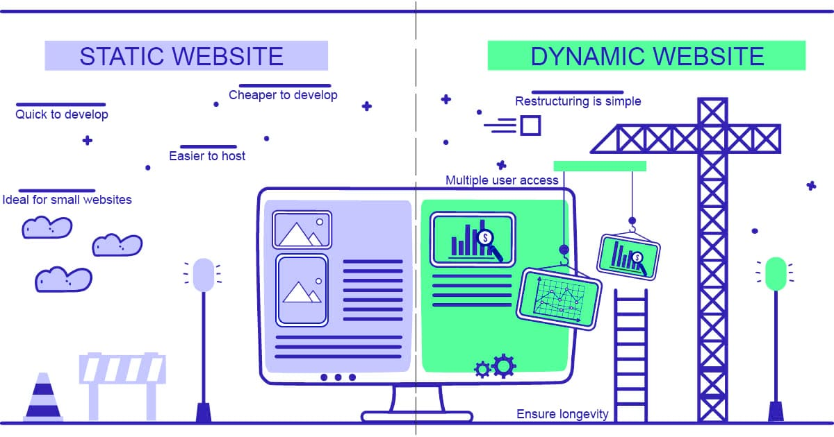




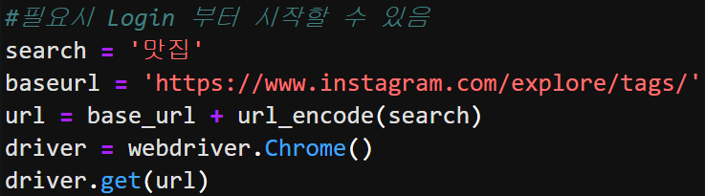
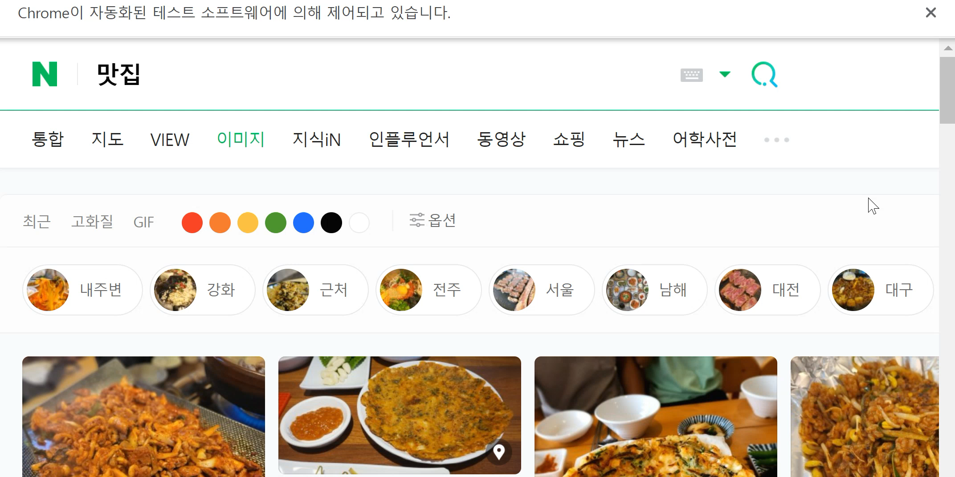
Data Collection
Static & Dynamic Web
Dynamic Web Scraping
Static Information
- Hardly changes
Dynamic Information
Changes frequently
: related to events in network

Slide 2






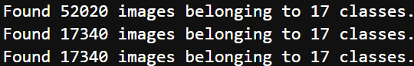
Data Augmentation & Train-Test Split
Data Augmentation
Train-Test Split
Original Picture
Train data
60%
Validation data
20%
Test data
20%
Center Crop & Resize
Rotate
200 pixels
m pixels
Original Pictures
180pic/class
60pic/class
60pic/class
+
Data Augmentation
200 pixels
Augmented Pictures
n pixels
3,060pic/class
1,020pic/class
1,020pic/class
flow_from_directory

